Slide 1
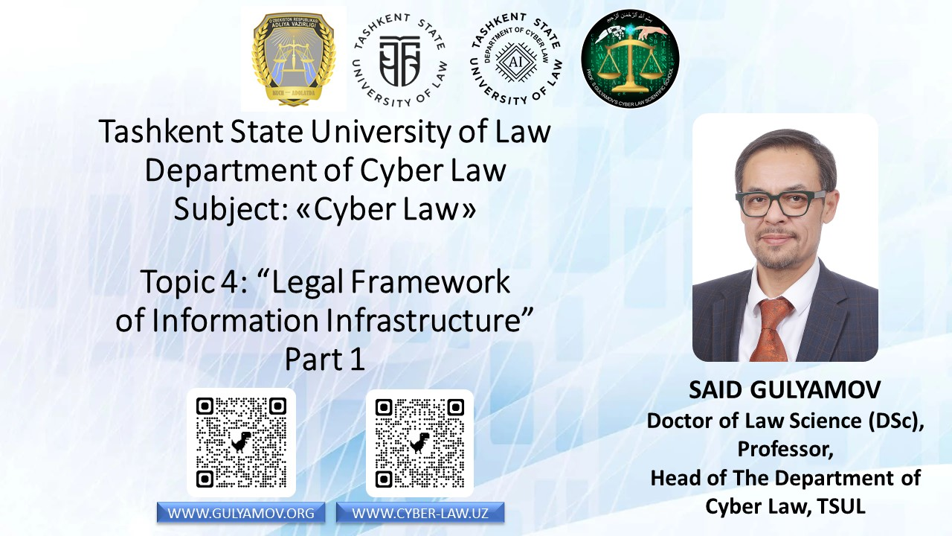

Slide 2

Introduction to Information Infrastructure Regulation
Information infrastructure encompasses interconnected systems facilitating data flow in society.
Key concepts in information infrastructure regulation include network neutrality, critical information infrastructure, and digital sovereignty.
Regulation can be conceptualized through physical, logical, and content layers, each requiring tailored legal approaches.
As technologies like 5G and IoT emerge, legal frameworks must adapt to new challenges while balancing innovation, security, and individual rights.
The physical layer often falls under telecommunications law, while the content layer intersects with intellectual property and privacy regulations.

Slide 3
Information Infrastructure Objects
Information infrastructure objects include telecommunications networks, data centers, cloud computing infrastructure, and Internet exchange points (IXPs).
Submarine cables, satellite systems, and the domain name system are also crucial components of information infrastructure.
Telecommunications networks are subject to extensive national and international regulations.
Data centers and cloud infrastructure face issues of data sovereignty and cross-border flows.
The interconnectedness of these objects necessitates a holistic regulatory approach considering the interplay between various components and their legal regimes.

Slide 4
Stakeholders in Information Infrastructure Regulation
States play a crucial role by enacting laws, participating in treaties, and engaging in cyber operations.
International organizations like ITU and ICANN coordinate global efforts in information infrastructure regulation.
Internet service providers face legal obligations as seen in landmark cases.
Content providers and platforms are scrutinized for content moderation and data protection practices.
The complex interplay between these stakeholders necessitates a multifaceted regulatory approach balancing competing interests.

Slide 5
Critical Information Infrastructure Protection
The EU NIS Directive provides a comprehensive framework for critical information infrastructure protection.
The US Critical Infrastructures Protection Act emphasizes public-private partnerships in CII protection.
Russia's Federal Law introduces a classification system for CII objects.
China's Cybersecurity Law establishes a comprehensive regime with data localization requirements.
Implementing CII protection regimes presents challenges in defining scope and addressing cross-border dependencies.

Slide 6
Network Neutrality
Network neutrality is the principle of equal data treatment in information infrastructure regulation.
The EU Regulation 2015/2120 establishes strong safeguards, prohibiting blocking, throttling, and paid prioritization.
The US has experienced regulatory fluctuations regarding network neutrality.
India bans zero-rating practices, while Brazil enshrines net neutrality in national law.
Enforcement faces challenges with 5G and IoT technologies, leading to debates between strict neutrality and 'reasonable network management' exceptions.

Slide 7
Data Localization and Cross-Border Flow Regulations
Russia and China impose strict data localization requirements for certain types of data.
The EU's GDPR allows data transfers under specific conditions, balancing protection with data mobility.
India proposes a hybrid model for data localization and cross-border flows.
Data localization requirements often conflict with international trade agreements like USMCA.
Balancing national security concerns with free data flow benefits remains a key challenge for policymakers.

Slide 8
Emerging Technologies and Information Infrastructure Regulation
5G networks prompt new regulatory approaches focusing on security and vendor trust.
Software-defined networking and network function virtualization reshape network architecture, requiring regulatory adaptations.
Edge computing raises questions about jurisdiction in distributed environments.
IoT in infrastructure presents unique security challenges for regulators.
Quantum communications promise unprecedented security but may render current protections obsolete.

Slide 9
Cybersecurity in Information Infrastructure Regulation
The EU NIS Directive establishes security requirements for essential services.
The US Cybersecurity Information Sharing Act facilitates threat indicator sharing among entities.
Singapore implements a licensing regime for cybersecurity providers to ensure quality and reliability.
The NIST Cybersecurity Framework provides a flexible risk management approach for organizations.
Case studies like the 2017 NotPetya attack illustrate complexities in applying regulations to major cybersecurity breaches.

Slide 10
International Cooperation in Information Infrastructure Regulation
The Internet Governance Forum serves as a multistakeholder platform for global discussion.
The WSIS process has influenced global policies, emphasizing digital divide bridging.
The UN Group of Governmental Experts has established norms for responsible state behavior in cyberspace.
The Budapest Convention provides a framework for combating cybercrime across borders.
Achieving global consensus remains challenging, as evidenced by contentious outcomes of international conferences.

Slide 11
Future of Information Infrastructure Regulation
Information infrastructure regulation remains dynamic and evolving to address new challenges.
Future regulation will likely emphasize flexibility and adaptability to technological changes.
Multistakeholder initiatives are poised to drive regulatory evolution in the coming years.
Reconciling national interests with global approaches will be a central tension in future regulations.
A holistic approach considering technology, law, and society relationships is necessary for shaping our digital future.

Slide 12
Introduction to Artificial Intelligence (AI)
AI simulates human cognitive functions, evolving from narrow to general AI.
Key techniques in AI include machine learning and neural networks.
The EU's 'White Paper on AI' highlights AI's role in addressing societal challenges and economic growth.
AI's advancement raises legal and ethical debates on data privacy, algorithmic bias, liability, and autonomous decision-making.
The field's complexity requires interdisciplinary approaches to develop effective governance strategies.

Slide 13
Types of AI Systems
AI systems are categorized based on capabilities and potential impacts, ranging from reactive machines to self-aware AI.
Applications of AI span natural language processing, computer vision, robotics, and expert systems.
The EU emphasizes evaluating AI based on specific applications and risks.
Explainable AI addresses the need for transparency in decision-making processes.
Legal frameworks must adapt to address nuanced implications of different AI types while maintaining flexibility for future advancements.

Slide 14
Legal Definitions of AI
The EU's AI Act defines AI as software generating outputs influencing environments.
The OECD describes AI as systems making predictions or decisions affecting real or virtual environments.
UNESCO emphasizes AI's capacity to process data resembling intelligent behavior.
The US focuses on systems performing tasks without significant human oversight.
China highlights AI's ability to simulate and extend human intelligence.

Slide 15
AI and Intellectual Property
AI-generated works raise questions about copyright ownership, as seen in cases like Naruto v. Slater.
Patent law debates AI inventorship, exemplified by DABUS patent applications.
Trade secret protection gains importance for AI algorithms.
Trademark law faces questions about AI-generated brands.
IP law must evolve to balance AI development incentives with fundamental IP principles.

Slide 16
AI and Data Protection
The GDPR addresses AI concerns, particularly automated decision-making.
Data minimization challenges arise in machine learning contexts.
The right to explanation for AI decisions is debated in legal circles.
International data transfers for AI training face scrutiny post-Schrems II.
Privacy-preserving AI techniques offer promising solutions to data protection challenges.

Slide 17
AI Liability and Accountability
Product liability laws are being reevaluated for AI's unique characteristics.
Attributing fault in AI-caused damages is complex and challenging.
The EU's AI Act introduces requirements for high-risk AI systems.
Debates surround AI's legal status, including 'electronic personhood' proposals.
Legal frameworks must evolve to ensure clear accountability and appropriate remedies for AI-related harms.

Slide 18
Ethical Considerations in AI
The EU's Ethics Guidelines outline key requirements including human agency, transparency, and accountability.
The OECD AI Principles emphasize inclusive growth and sustainable development.
Industry initiatives demonstrate private sector commitment to responsible AI.
'Ethical by design' emphasizes integrating ethics throughout the AI lifecycle.
Key focus areas include fairness, transparency, privacy, and human-centric AI development.

Slide 19
AI Applications in Specific Sectors
Healthcare faces regulatory hurdles for AI medical devices.
Financial services grapple with AI in credit scoring and trading.
Autonomous vehicles face complex safety regulations.
Criminal justice debates AI-driven risk assessment tools.
AI content moderation impacts freedom of expression.

Slide 20
International Cooperation in AI Governance
Organizations like the UN, OECD, and Council of Europe develop principles for responsible AI.
The Global Partnership on AI bridges theory and practice in AI policy.
Regional efforts aim to align regulatory approaches across different jurisdictions.
Proposals for an international AI treaty reflect aspirations for cohesive global regulation.
Capacity building initiatives ensure inclusive global AI development.

Slide 21
Future of AI Regulation
Adaptive approaches like regulatory sandboxes test AI applications while informing policy.
Interdisciplinary collaboration is essential in AI governance.
Public engagement builds trust in AI policy-making.
Global cooperation addresses AI's cross-border nature.
Future AI regulation will likely involve a multi-layered approach combining international principles, national legislation, sector-specific rules, and ethical guidelines.

Slide 22
Introduction to Blockchain Technology
Blockchain is a distributed ledger enabling secure, transparent record-keeping without central authority.
Key components include distributed networks, cryptographic hashing, and consensus mechanisms.
Blockchain has evolved from cryptocurrency to smart contracts and decentralized applications.
The technology has the potential to transform various economic sectors, as noted by the World Economic Forum.
Blockchain adoption presents legal and regulatory challenges in data protection, contract law, securities regulation, and international trade.

Slide 23
Technical Foundations of Blockchain
Cryptographic hash functions ensure data integrity and immutability in blockchain systems.
Consensus mechanisms like Proof of Work and Proof of Stake maintain decentralization.
Smart contracts enable automated, self-executing agreements on blockchain platforms.
Challenges in blockchain technology include scalability, privacy, and interoperability.
The complex interplay between blockchain's technical features and legal frameworks necessitates ongoing adaptation of regulations.

Slide 24
Legal Status of Blockchain
The EU's 'Blockchain Now and Tomorrow' report outlines potential applications and regulatory considerations.
The US proposed a 'Blockchain Promotion Act' to develop a common federal definition.
China regulates blockchain-based information services with specific legal frameworks.
Malta established a comprehensive regulatory framework for innovative technologies, including blockchain.
Creating a universally accepted legal definition of blockchain remains challenging due to its complexity and rapid evolution.

Slide 25
Blockchain in Financial Services
Cryptocurrency regulations vary widely, from comprehensive frameworks like EU's MiCA to case-by-case approaches in the US.
Central bank digital currencies are being explored globally as a blockchain application in finance.
Blockchain in securities trading raises questions about tokenized securities and existing regulations.
The rise of decentralized finance (DeFi) and stablecoins has prompted regulatory scrutiny.
Key issues include token classification, regulatory jurisdiction, and the application of existing financial laws to blockchain-based assets and services.

Slide 26
Smart Contracts and Contract Law
Smart contracts present unique challenges to traditional contract law, particularly in meeting legal requirements for contract formation.
Some jurisdictions explicitly recognize smart contracts in their legal frameworks.
The immutable nature of smart contracts raises issues in dispute resolution, prompting blockchain-native solutions.
Liability issues from smart contract failures underscore the need for clear legal frameworks.
Key legal considerations include contract formation, interpretation, dispute resolution, and liability allocation in automated, code-based agreements.

Slide 27
Blockchain and Data Protection
Blockchain's immutability conflicts with GDPR principles like the right to erasure.
Personal data definition in public blockchains raises complex questions for data protection.
Proposed solutions to address data protection concerns include zero-knowledge proofs and off-chain storage.
Cross-border data transfers raise concerns, especially in light of the Schrems II decision.
Key issues include reconciling blockchain's immutability with data subject rights and ensuring GDPR compliance in decentralized systems.

Slide 28
Blockchain and Intellectual Property
Blockchain is explored for anti-counterfeiting and efficient IP registries.
Blockchain-based innovations raise questions about patentability and IP protection.
Creative industries explore new digital rights management models using blockchain technology.
IP tokenization presents novel legal challenges in ownership and transfer of rights.
Key legal issues include IP protection for blockchain innovations, tokenization of IP rights, and adapting existing IP laws to blockchain-based ownership models.

Slide 29
Sector-Specific Blockchain Applications
In supply chains, blockchain raises data sharing and antitrust questions.
Healthcare applications must navigate patient privacy regulations when implementing blockchain solutions.
Real estate transactions on blockchain require integration with existing property rights frameworks.
Blockchain voting faces hurdles in ensuring voter privacy and compliance with electoral laws.
Each sector presents specific regulatory challenges requiring tailored approaches to blockchain integration.

Slide 30
International Approaches to Blockchain Regulation
Organizations like OECD, FSB, and IOSCO examine blockchain's implications for various sectors.
The World Bank explores blockchain's potential for development in international contexts.
Regional initiatives like the European Blockchain Partnership demonstrate collaborative approaches to regulation.
International organizations address blockchain's cross-border implications in areas like digital identity and financial crimes prevention.
Key focus areas include developing harmonized standards, addressing cross-border challenges, and ensuring equitable participation in the global blockchain ecosystem.

Slide 31
Future of Blockchain Regulation
Blockchain regulation requires balancing innovation with societal safeguards.
A technology-neutral, principle-based approach is often advocated for blockchain regulation.
International cooperation is crucial for addressing cross-border applications of blockchain technology.
Public-private partnerships are key in developing effective blockchain governance frameworks.
The future likely involves a multi-layered approach combining international principles, national legislation, sector-specific rules, and ethical guidelines for blockchain regulation.

Slide 32
Introduction to Robotics and Unmanned Aerial Vehicles (Drones)
Robots are defined as programmable, actuated mechanisms with autonomy, while drones are unmanned aircraft systems.
These technologies have evolved from industrial robots to advanced autonomous systems.
The global industrial robot market was valued at $16.5 billion in 2020, indicating substantial economic impact.
The advancement of robotics and drones raises legal and ethical challenges in safety, liability, privacy, and socioeconomic impacts.
Comprehensive legal frameworks are necessary to govern their development and use, balancing innovation with societal safeguards.

Slide 33
Legal Definitions and Classifications
South Korea defines intelligent robots as self-perceiving, autonomous mechanical devices.
The EU's proposed AI Act encompasses AI-enabled robots in its regulatory framework.
The FAA categorizes drones based on weight and use for regulatory purposes.
The SAE's levels of driving automation offer a framework for categorizing autonomous systems.
Key issues include defining autonomy, classifying based on capabilities, and addressing the legal status of highly autonomous systems.

Slide 34
Safety Regulations for Robotics
ISO standards establish requirements for industrial and collaborative robots.
The EU's Machinery Directive mandates safety requirements for robots.
OSHA provides guidelines for robotics safety in workplaces to ensure human worker protection.
Medical robots face additional scrutiny from regulators like the FDA due to their critical applications.
The concept of 'ethical risk assessment' aims to incorporate ethical considerations into safety evaluations for robotic systems.

Slide 35
Drone Regulations
The FAA's Part 107 establishes rules for small UAS operations in the United States.
The EU implemented a comprehensive framework categorizing drone operations based on risk.
ICAO provides guidance on RPAS certification and air traffic management for international standardization.
Unmanned Traffic Management (UTM) aims to integrate drones into airspace safely.
Key regulatory issues include operational limitations, risk-based categorization, integration with existing airspace, and balancing innovation with safety and privacy concerns.

Slide 36
Liability and Insurance Frameworks
The EU Product Liability Directive provides a foundation for liability, but its application to autonomous systems is challenging.
Attributing fault in accidents involving autonomous robots is complex and requires new legal approaches.
International frameworks like the Rome Convention address aircraft damage liability for drone operations.
Specialized insurance products are emerging to cover risks associated with robotics and drone operations.
As these technologies advance, liability regimes must adapt to ensure fair responsibility allocation and adequate protection for affected parties.

Slide 37
Privacy and Data Protection
GDPR principles apply to data collected by robotics and drone technologies.
'Privacy by design' emphasizes integrating privacy considerations throughout the development process.
Drone surveillance raises legal questions about technological surveillance boundaries and individual privacy rights.
Data Protection Impact Assessments (DPIAs) are crucial for identifying and mitigating privacy risks in robotic and drone applications.
Balancing benefits with privacy protection remains a crucial challenge for regulators and developers of robotics and drone technologies.

Slide 38
Intellectual Property Rights
Patent protection drives innovation in robotics and drones, with ongoing debates on AI algorithm patentability.
Copyright protects robot software, while trade secrets cover manufacturing processes in the industry.
The open-source movement fosters collaboration in robotics and drone development.
Standard-essential patents are subject to FRAND licensing to ensure fair access to critical technologies.
Key issues include protecting AI innovations, balancing open-source and proprietary development, and addressing IP challenges in human-robot interaction.

Slide 39
Ethical and Societal Implications
Asimov's Laws continue to influence ethical AI design discussions in robotics.
Healthcare robotics raise questions about patient autonomy and the role of machines in care.
Employment impact studies analyze job displacement and creation resulting from robotics and automation.
Military robotics spark debates on the ethics of autonomous weapons systems.
Key ethical issues include human-robot interaction, societal impacts, privacy, and ensuring fairness and sustainability in robotic systems development and deployment.

Slide 40
International Governance
UN agencies address various aspects: CCW debates autonomous weapons, ITU discusses spectrum allocation, and ICAO develops standards for airspace integration.
The OECD contributes to AI policy discussions, providing guidelines for responsible development.
ISO establishes robotics standardization committees to ensure global consistency in standards.
Proposals for dedicated international agencies reflect the need for coordinated oversight of robotics and drone technologies.
Key focus areas include harmonizing standards, addressing cross-border challenges, and ensuring inclusive global governance of robotics and drone technologies.

Slide 41
Future of Robotics and Drone Regulation
Adaptive approaches are essential to keep pace with rapid advancements in robotics and drone technologies.
International cooperation is crucial for developing harmonized frameworks for global use of these technologies.
Public engagement builds trust in policy-making processes for robotics and drone regulation.
Interdisciplinary collaboration is essential for effective governance of these complex technologies.
Future regulation will likely involve a multi-layered approach combining international principles, national legislation, sector-specific rules, and ethical guidelines for robotics and drones.

Slide 42
Introduction to the Internet of Things (IoT)
The Internet of Things (IoT) is a network of interconnected objects capable of collecting and exchanging data.
Core components of IoT include sensors, actuators, connectivity modules, and data processing units.
IoT applications span sectors like smart homes, industrial automation, and healthcare.
The economic impact of IoT is substantial, with projected values of up to $11.1 trillion annually by 2025.
Key challenges include ensuring device security, protecting user privacy, and developing adaptive regulations for IoT.

Slide 43
IoT Architecture
IoT architecture is typically conceptualized in layers: physical, network, middleware, and application.
The network layer employs protocols like MQTT and CoAP for efficient data transmission.
Middleware standards like oneM2M enable interoperability between diverse IoT devices and systems.
Edge computing aims to address latency and bandwidth constraints in IoT deployments.
ISO/IEC 30141:2018 provides a comprehensive IoT Reference Architecture for standardization.

Slide 44
Security and Privacy in IoT
The OWASP IoT Top 10 identifies critical vulnerabilities specific to IoT systems.
Encryption challenges in IoT are addressed by NIST's lightweight cryptography project.
Authentication and access control in IoT are complex, with standards like OAuth 2.0 for IoT being proposed.
Privacy by Design is particularly relevant to IoT development to ensure user data protection.
Key focus areas include developing resource-efficient security measures and implementing robust authentication mechanisms for diverse IoT devices.

Slide 45
Legal Frameworks for IoT
The EU's Cybersecurity Act establishes IoT security certification standards.
The US IoT Cybersecurity Improvement Act sets security standards for federal agencies' IoT devices.
California's SB-327 requires reasonable security features for connected devices sold in the state.
GDPR application to IoT presents challenges in obtaining user consent and ensuring data rights.
Key regulatory focuses include security standards, data protection compliance, and addressing the unique challenges of IoT in various sectors.

Slide 46
Data Ownership and IP Rights in IoT
Applying traditional IP laws to IoT-generated data is challenging, as seen in cases like Football Dataco v Yahoo!.
Contracts play a crucial role in establishing data rights in IoT ecosystems.
IP protection for IoT devices and software faces unique challenges, exemplified by cases like Thales v. Philips.
Standardization efforts and patent pools aim to streamline licensing in the IoT industry.
Key issues include defining data ownership, balancing proprietary and open-source development, and addressing IP challenges in interconnected IoT ecosystems.

Slide 47
Consumer Protection in IoT
The EU's General Product Safety Directive addresses connected product safety for consumer IoT devices.
FTC cases highlight challenges in regulating IoT marketing claims and ensuring consumer protection.
IoT obsolescence focuses on the right to repair and sustainable design principles.
Informed consent for IoT data collection is challenging due to the pervasive nature of IoT devices.
International standards like ETSI EN 303 645 provide baselines for consumer IoT security.

Slide 48
Sector-Specific IoT Applications
Healthcare IoT must comply with regulations like HIPAA and FDA guidance.
Smart city initiatives face data protection issues, addressed in frameworks like Barcelona's ethical standards.
Connected vehicles prompt new regulations such as UNECE WP.29 for automotive cybersecurity.
Industrial IoT adheres to standards like IEC 62443 for operational technology security.
Each sector requires tailored regulatory approaches addressing unique risks and opportunities presented by IoT integration.

Slide 49
IoT Liability Regimes
The EU Product Liability Directive's application to IoT systems with software and updates is challenging.
Attributing fault in multi-stakeholder IoT ecosystems is complex and requires new legal frameworks.
IoT data accuracy liability has emerged in smart meter disputes, highlighting new areas of legal concern.
Smart contracts and blockchain present opportunities and challenges for automated liability management in IoT.
Key issues include adapting traditional liability frameworks to IoT complexities and developing new models for shared responsibility in IoT ecosystems.

Slide 50
International IoT Governance
ITU, ISO, and IEC develop international standards for IoT technologies and applications.
Regional initiatives like the EU's AIOTI demonstrate the strategic importance of IoT in economic development.
International cooperation on IoT cybersecurity is exemplified by initiatives like the Paris Call for Trust and Security.
Global interoperability remains a challenge, addressed by efforts like IIC's testbeds for cross-industry collaboration.
Harmonizing regulations across jurisdictions remains challenging, requiring ongoing international cooperation in IoT governance.

Slide 51
Future of IoT Regulation
IoT regulation requires balancing innovation with protections for security, privacy, and consumer rights.
Risk-based approaches allow for tailored security measures appropriate to different IoT applications.
Transparency and explainability are essential for trust and accountability in IoT systems.
Continuous regulatory assessment is necessary to keep pace with rapid advancements in IoT technologies.
Future IoT regulation will likely involve a multi-layered approach combining international principles, national legislation, sector-specific rules, and ethical guidelines.

Slide 52


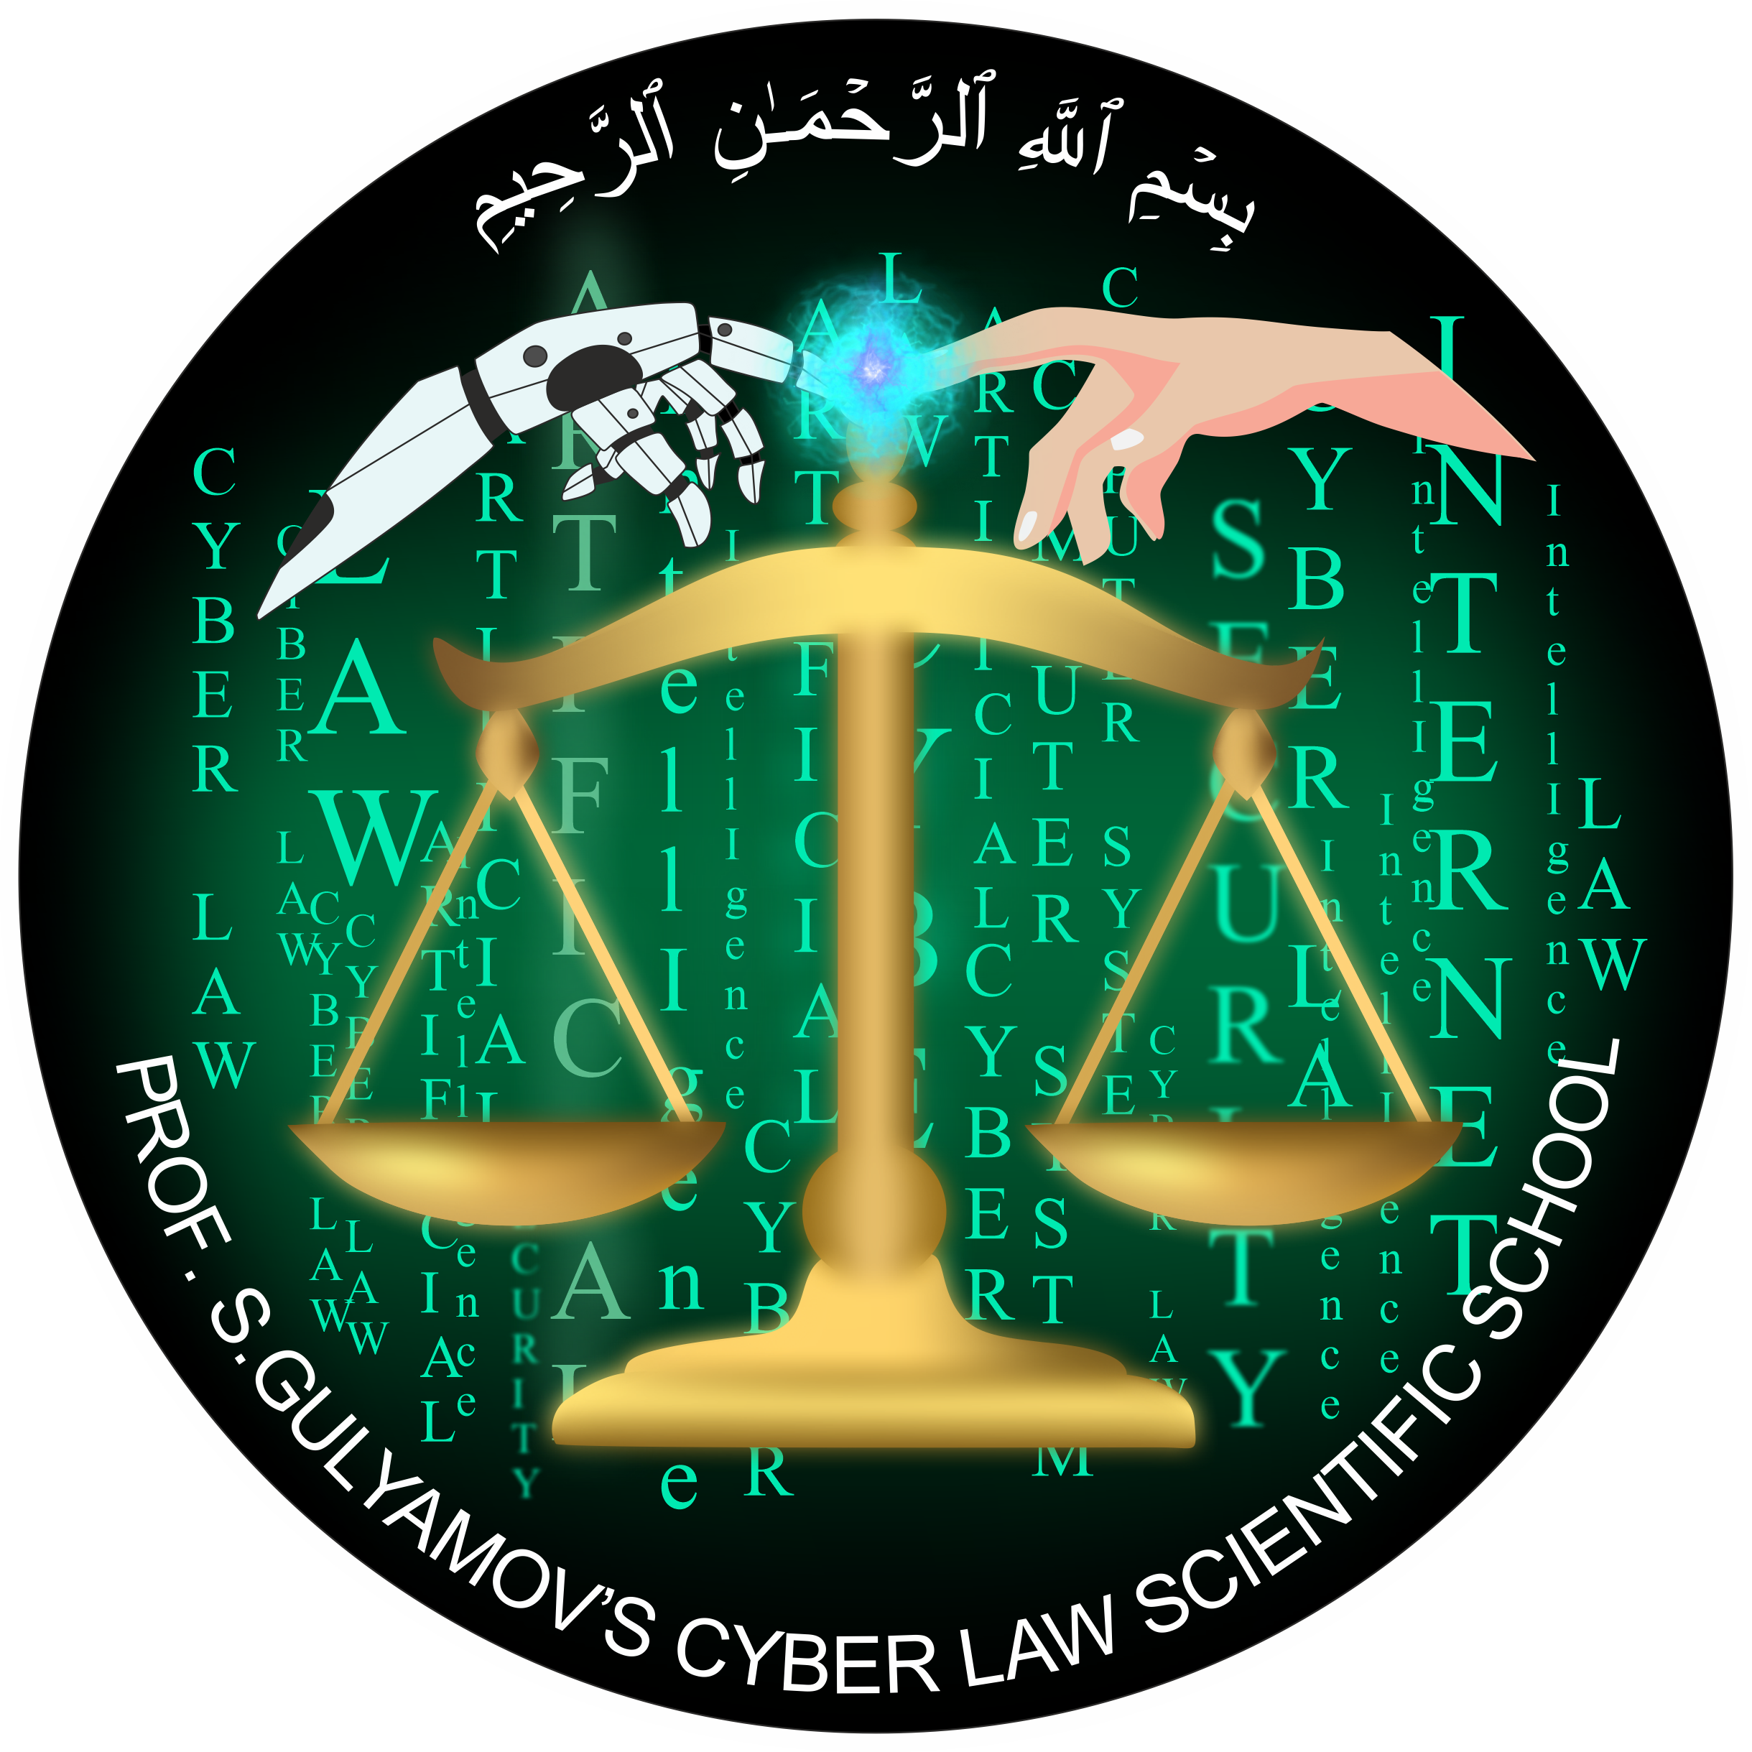
THANK YOU FOR THE ATTENTION!
WWW.GULYAMOV.ORG

